Slide 1
.REACT
Lesson 1: Components

Slide 2
Components
Multi-Page vs. Single-Page
Meet React
Dealing with JSX
Node
Hello World
Properties
Components
Styling in React
Complex Components

Slide 3
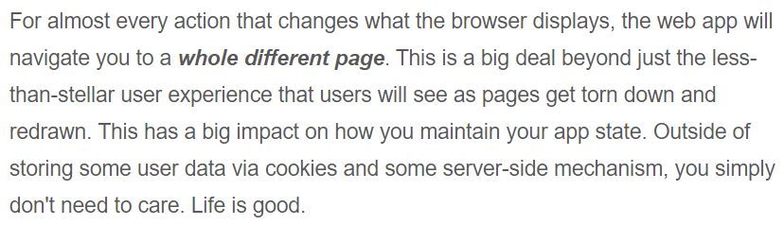
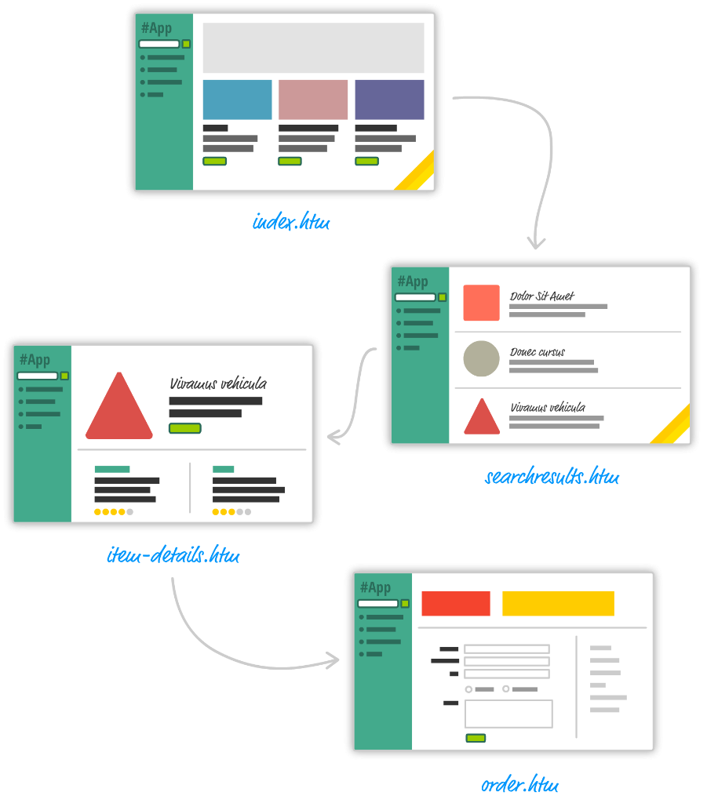
Multi-page design

Slide 4
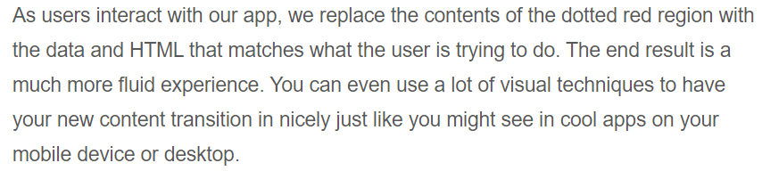
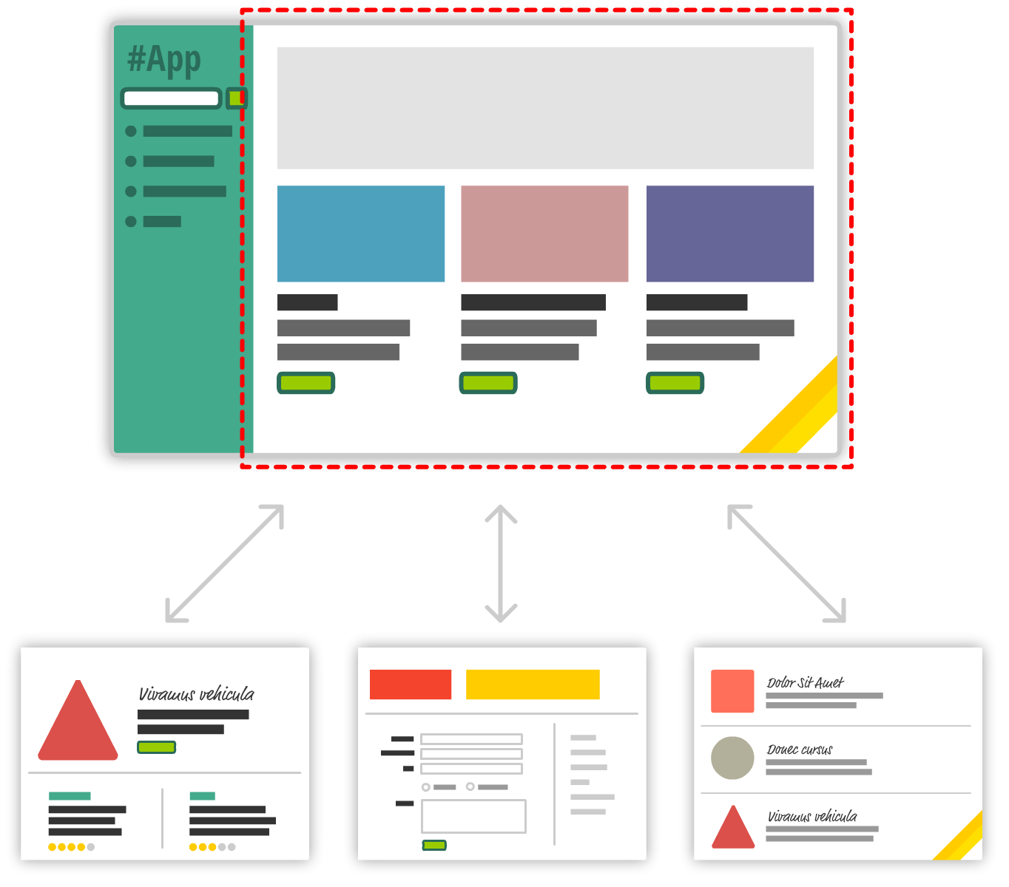
Single-Page App (SPA)

Slide 5

Javascript Frameworks

Slide 6














Meet React

Slide 7
Meet React
Lightning-fast DOM Manipulation
Encourages the Creation of Truly Composable UI
Visuals Defined Entirely in JavaScript
Just the V in an MVC Architecture

Slide 8
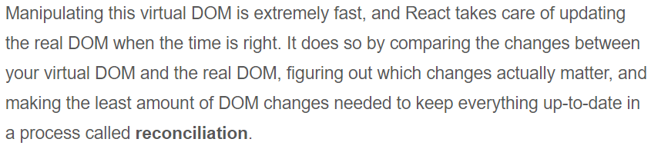
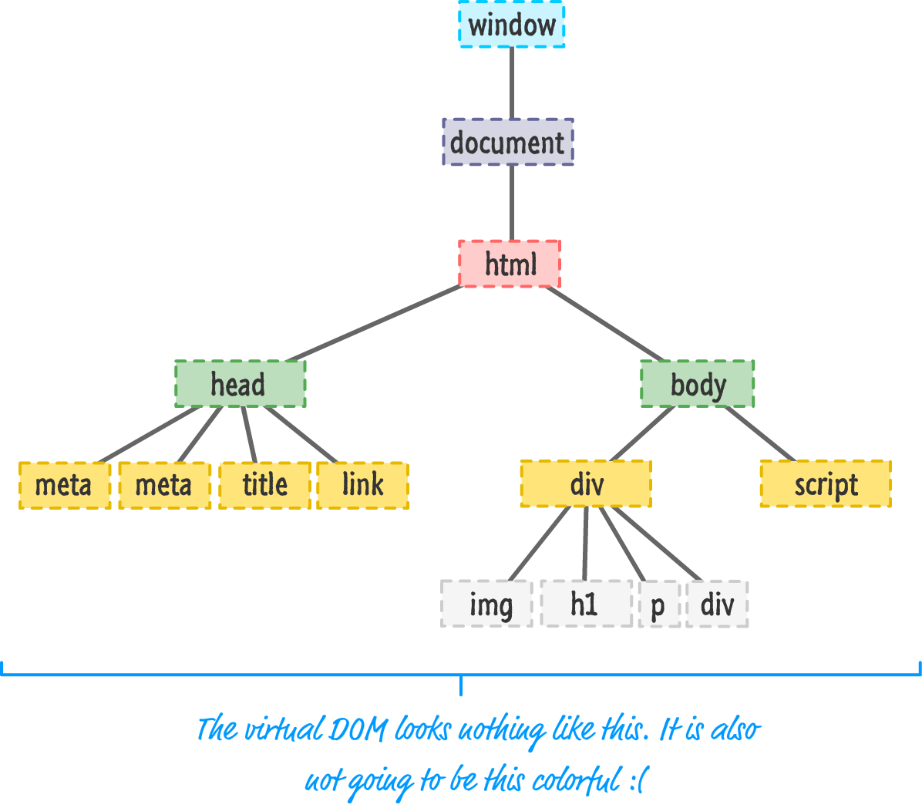
Lightning-fast DOM Manipulation

Slide 9
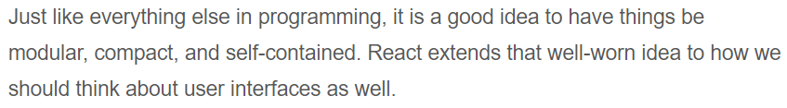
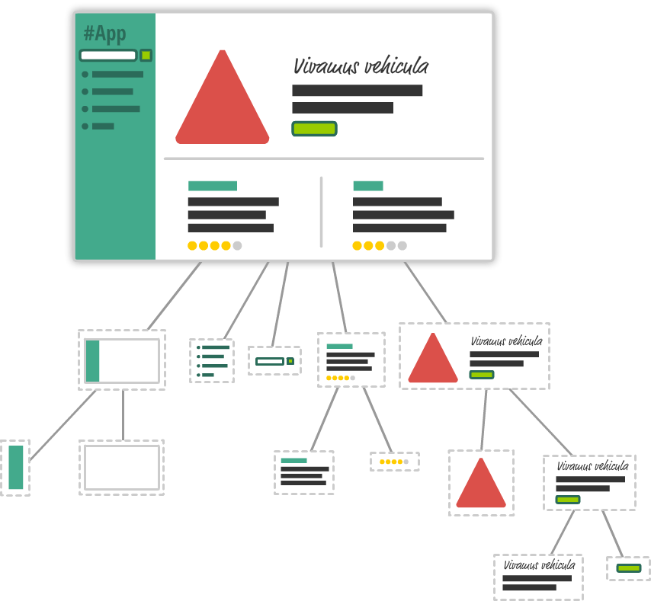
Encourages the Creation of Truly Composable UI

Slide 10
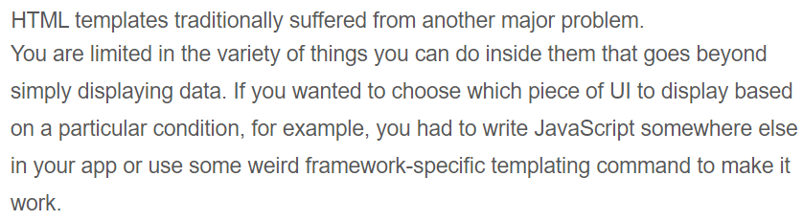
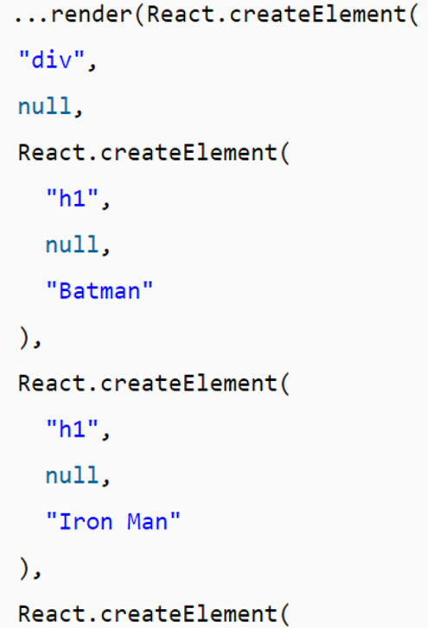
Visuals Defined Entirely in JavaScript

Slide 11
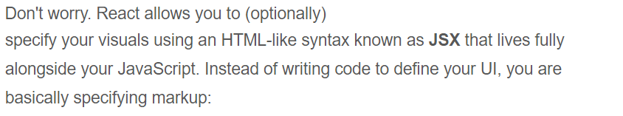
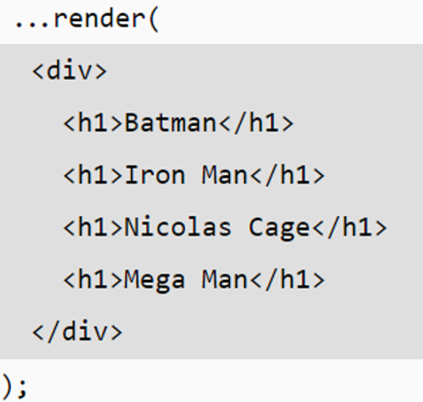
JSX

Slide 12
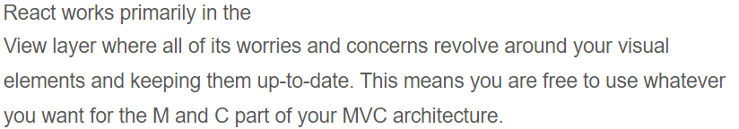
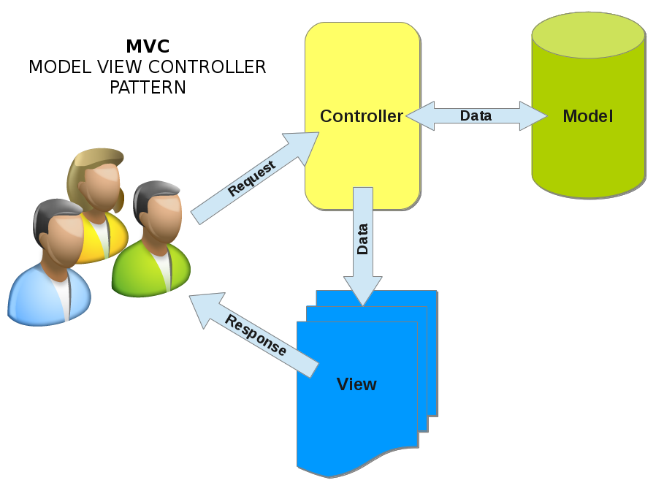
Just the V in an MVC Architecture

Slide 13
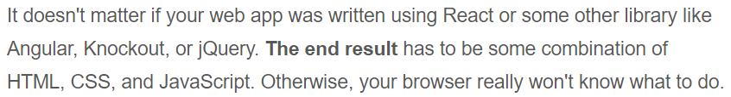
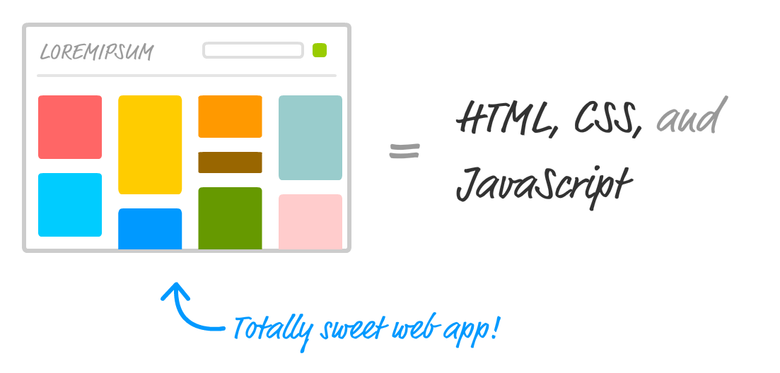
JSX ⇨ Babel ⇨ JavaScript

Slide 14
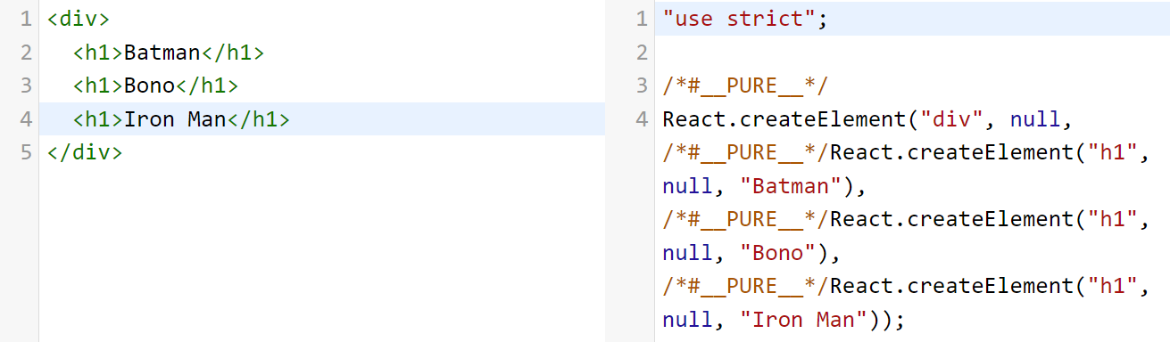
JSX ⇨ Babel ⇨ JavaScript
http://babeljs.io
Try it out

Slide 15
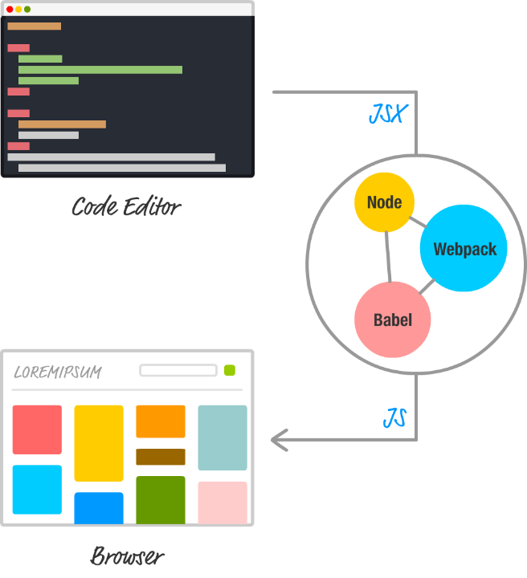
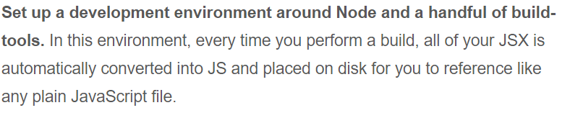
Node

Slide 16

Node.js
https://nodejs.org/en/
node -v
Create a folder for your React Apps (SourceCode)
c:\> node -v
v20.17.1

Slide 17
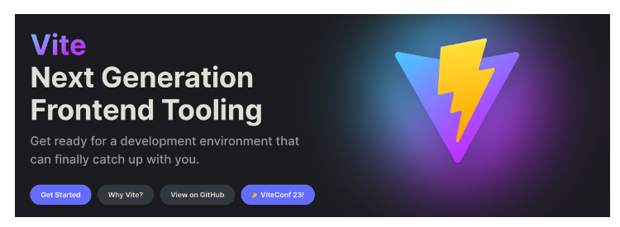
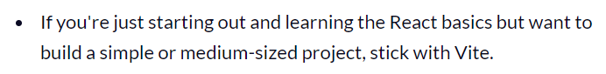
Vite

Slide 18
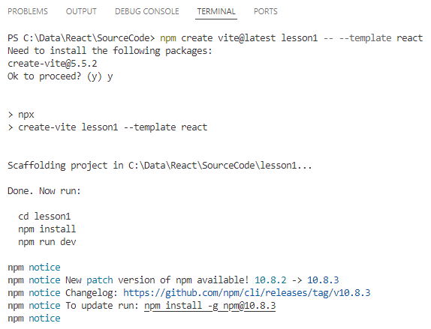
Create
VSCode|SourceCode
npm create vite@latest lesson1 -- --template react
Confirm the installation
of create-vite@5.5.2
File | Open Folder
lesson1

Slide 19
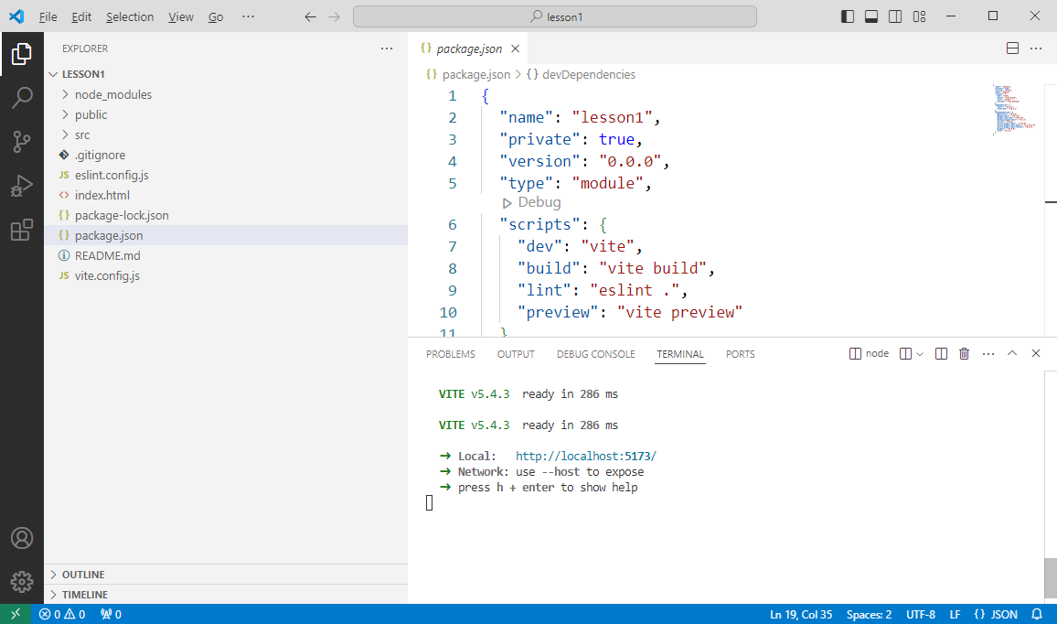
npm install
New Terminal
npm install
npm run dev

Slide 20
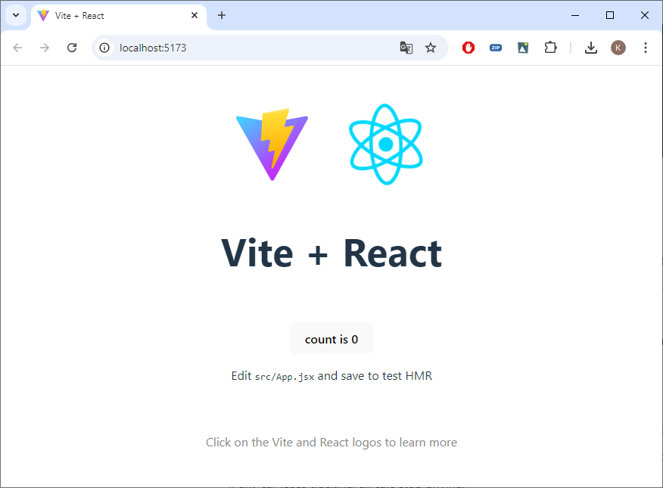
npm run dev

Slide 21
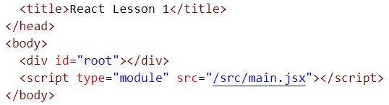
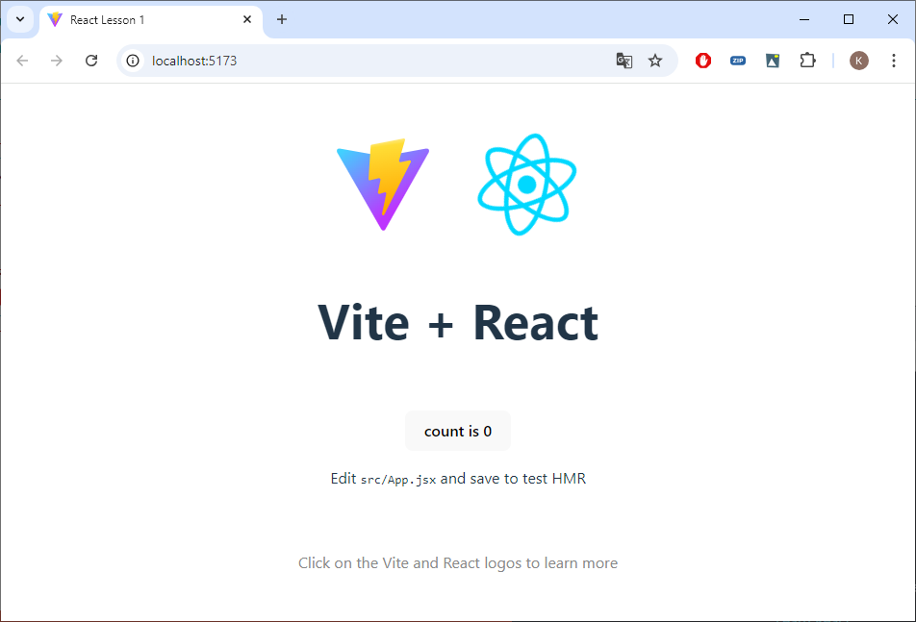
index.html

Slide 22
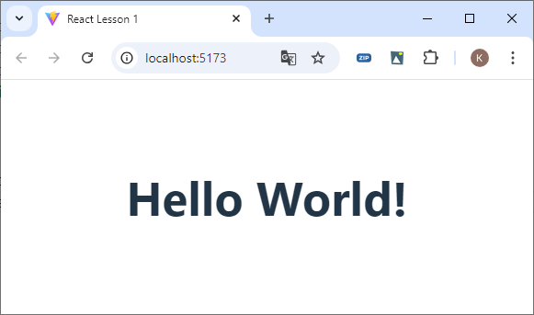
src/main.jsx (https://itf-code.netlify.app/react/)
createRoot(document.getElementById('root')).render(
<h1>Hello World!</h1>,
)
/*
createRoot(document.getElementById('root')).render(
<StrictMode>
<App />
</StrictMode>,
)
*/

Slide 23
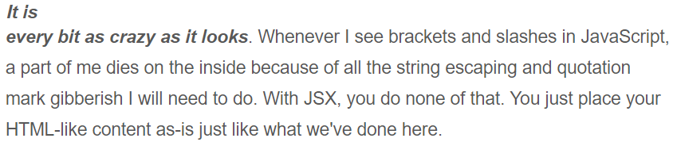
root.render
The root.render method takes one argument: the HTML-line elements (aka JSX) you wish to output into the root-div of your application.
....render( <h1>Hello world!</h1> )
....render(React.createElement( "h1", null, "Hello World!"))

Slide 24
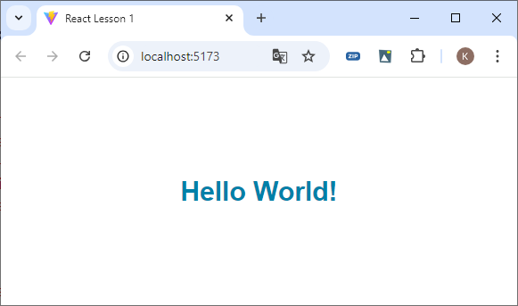
src/index.css
h1 {
font-size: 30px;
font-family: sans-serif;
color: #0080a8;
}

Slide 25
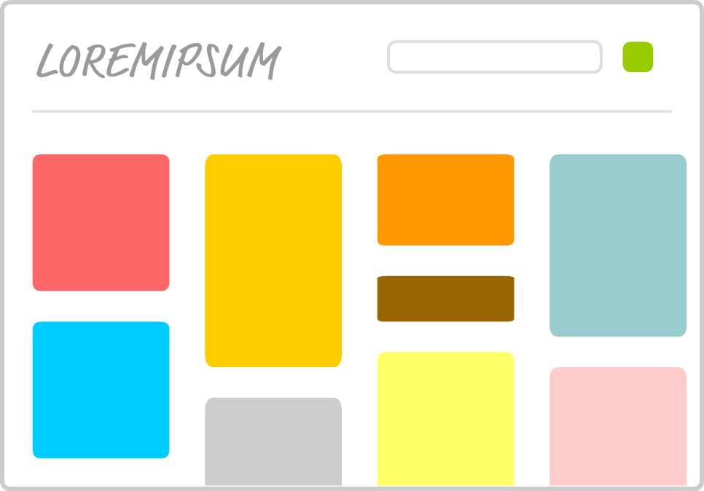
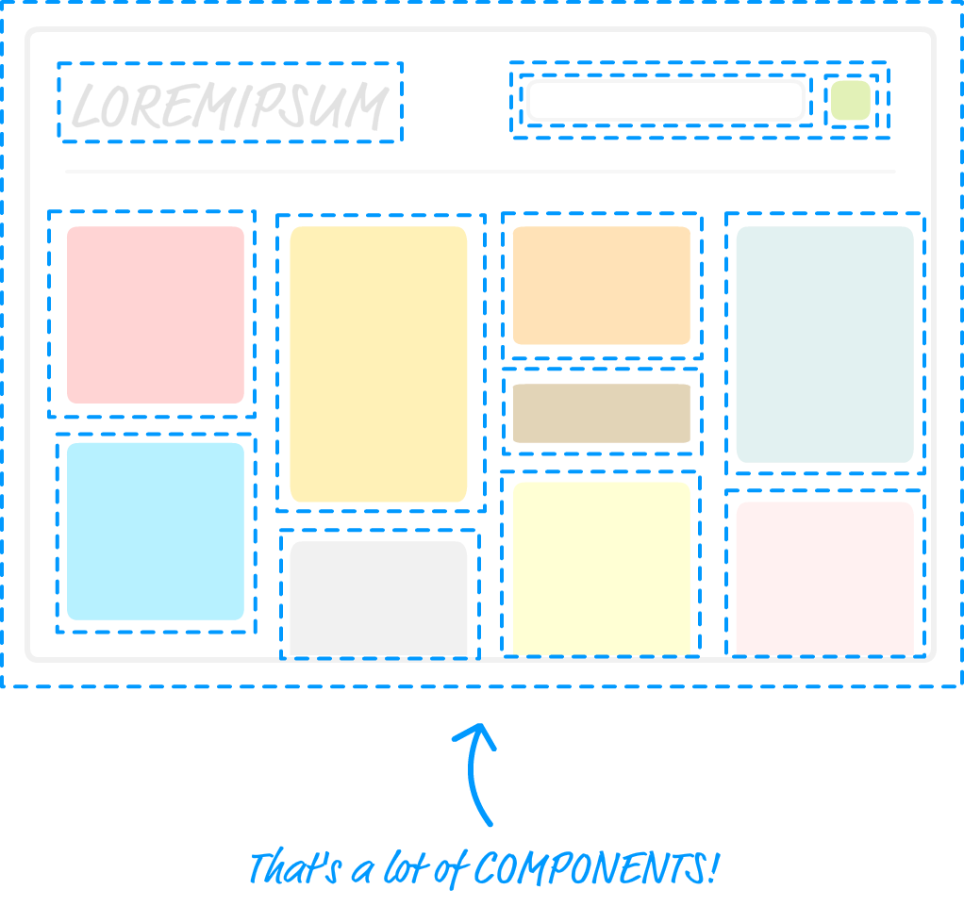
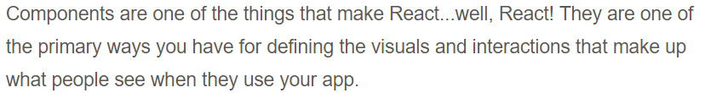
Components

Slide 26
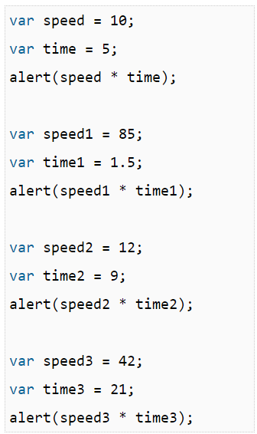
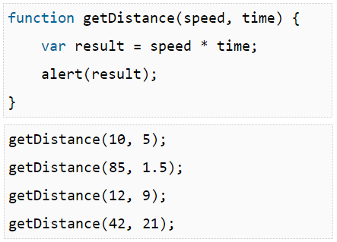
Why Components?

Slide 27
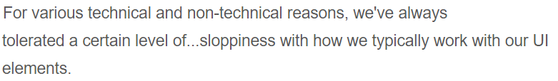
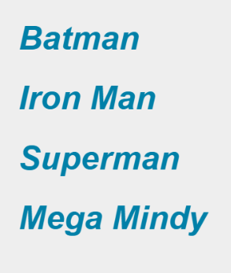
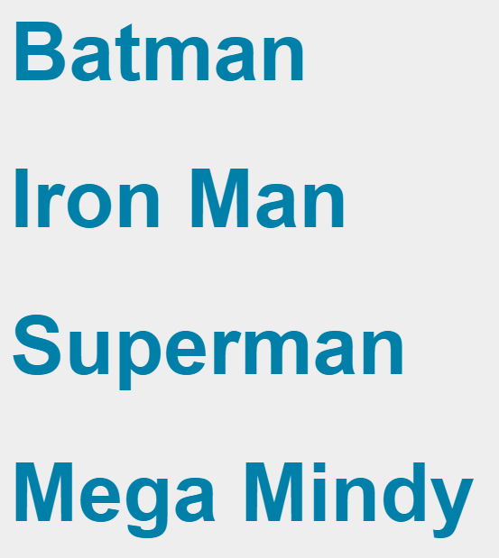
Why Components in react?
....render( <div> <h1>Batman</h1> <h1>Iron Man</h1> <h1>Superman</h1> <h1>Mega Mindy</h1> </div> );
....render( <div> <h3><i>Batman</i></h3> <h3><i>Iron Man</i></h3> <h3><i>Superman</i></h3> <h3><i>Mega Mindy</i></h3> </div> );

Slide 28
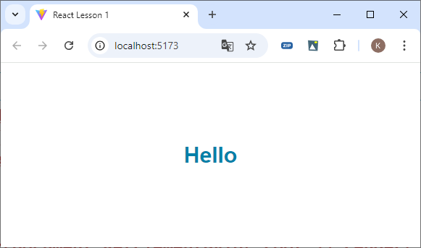
First Component (main.jsx)
function Hello() {
return (
<h1>Hello</h1>
);
}
createRoot(document.getElementById('root')).render(
<Hello />,
)

Slide 29
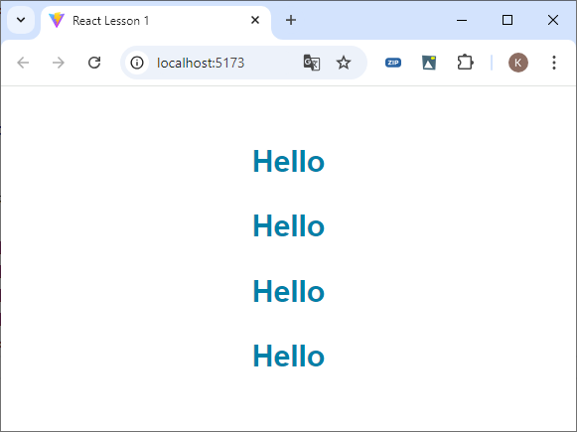
Components
Always one root tag
You can also use <> … </>
createRoot(document.getElementById('root')).render(
<div>
<Hello />
<Hello />
<Hello />
<Hello />
</div>,
)

Slide 30
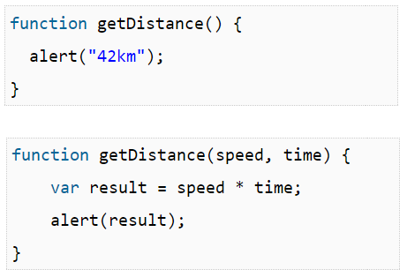
Parameters (Function World) ⇨ properties (component world)

Slide 31
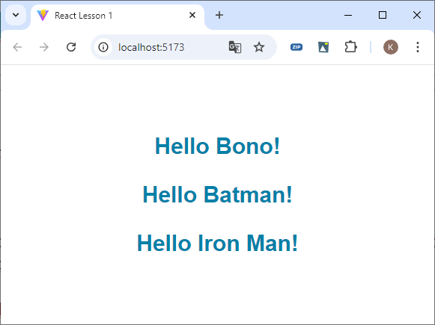
Properties or props
function Hello(props) {
return (
<h1>Hello {props.target}!</h1>
);
}
const root = createRoot(document.getElementById('root'));
root.render(
<div>
<Hello target="Bono" />
<Hello target="Batman" />
<Hello target="Iron Man" />
</div>
)

Slide 32
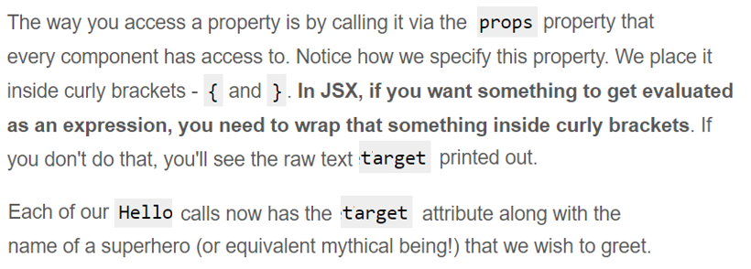
Props

Slide 33
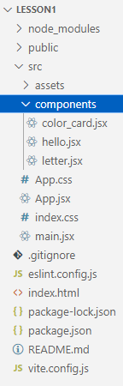
src/components - Best Practice
Copy components from Resources to src

Slide 34
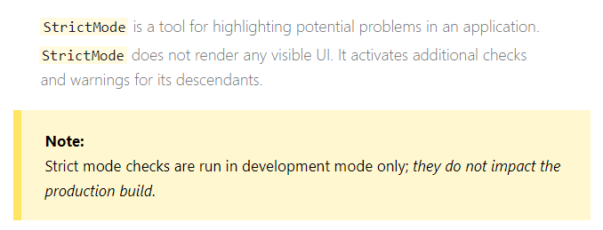
main.jsx
import { StrictMode } from 'react'
import { createRoot } from 'react-dom/client'
import App from './App.jsx'
import './index.css'
createRoot(document.getElementById('root')).render(
<StrictMode>
<App />
</StrictMode>,
)

Slide 35
App.jsx
import './App.css';
import Hello from './components/hello';
function App() {
return (
<div className="App">
<Hello target="Batman"/>
<Hello target="Bono"/>
</div>
);
}
export default App;

Slide 36
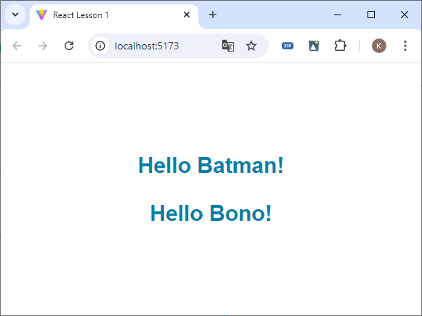
components/hello.jsx
function Hello(props) {
return (
<h1>Hello {props.target}!</h1>
);
}
// You don't need to make all functions
// in the component available, only 1 default
export default Hello;

Slide 37
props.children
import './App.css';
import Hello from './components/hello';
import Letter from './components/letter';
function App() {
return (
<div className="App">
<Hello target="Batman"/>
<Hello target="Bono"/>
<Letter>A</Letter>
<Letter>E</Letter>
<Letter>I</Letter>
<Letter>O</Letter>
<Letter>U</Letter>
</div>
);
}
function Letter(props) {
return (
// props.children returns the content
// of <Letter>...</Letter>
<div>{props.children}</div>
);
}
export default Letter;

Slide 38
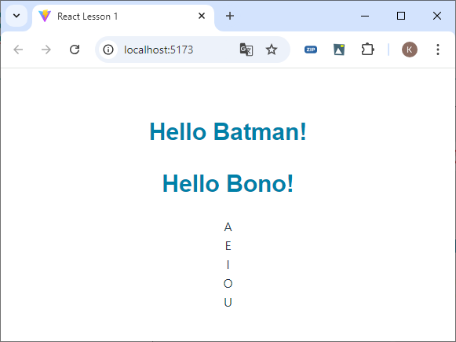
Letter

Slide 39
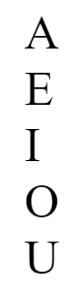

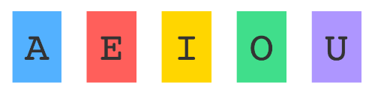
Styling in React
css style
Styling Content the React Way

Slide 40
a) Css Style in index.css
.letter {
padding: 10px;
margin: 10px;
background-color: #ffde00;
color: #333;
display: inline-block;
font-family: monospace;
font-size: 32px;
text-align: center;
}

Slide 41
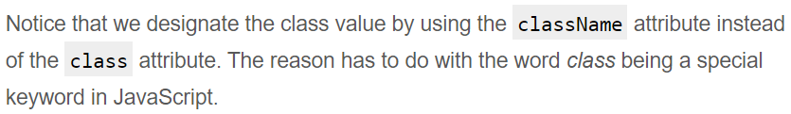
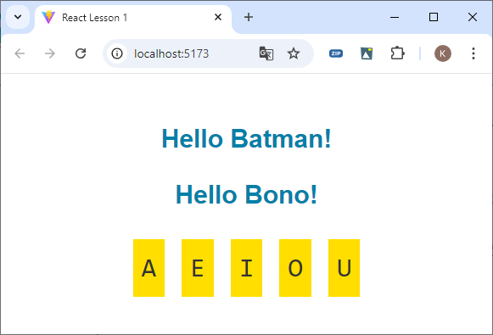
className
function Letter(props) {
return (
// props.children returns the content
// of <Letter>...</Letter>
<div className="letter">{props.children}</div>
);
}
export default Letter;

Slide 42
b) Styling Content the React Way
function Letter(props) {
const letterStyle = {
padding: 10,
margin: 10,
backgroundColor: "#aadeff",
color: "#333",
display: "inline-block",
fontFamily: "monospace",
fontSize: 32,
textAlign: "center"
};
return (
// props.children returns the content
// of <Letter>...</Letter>
<div style={letterStyle}>{props.children}</div>
);
}
.letter {
padding: 10px;
margin: 10px;
background-color: #ffde00;
color: #333;
display: inline-block;
font-family: monospace;
font-size: 32px;
text-align: center;
}

Slide 43


Styling Our Content

Slide 44

Making the Background Color Customizable
<Letter bgcolor="#58B3FF">A</Letter>
<Letter bgcolor="#FF605F">E</Letter>
<Letter bgcolor="#FFD52E">I</Letter>
<Letter bgcolor="#49DD8E">O</Letter>
<Letter bgcolor="#AE99FF">U</Letter>
const letterStyle = {
padding: 10,
margin: 10,
backgroundColor: props.bgcolor,
color: "#333",
display: "inline-block",
fontFamily: "monospace",
fontSize: 32,
textAlign: "center"
};

Slide 45


Best Practice

Slide 46


Creating Complex Components

Slide 47



Creating Complex Components

Slide 48

Color Card
import Hello from './components/hello';
import Letter from './components/letter';
import Card from './components/color_card';
function App() {
return (
<div className="App">
<Card />

Slide 49
Square - Label
function Label() {
const labelStyle = {
fontFamily: "sans-serif",
fontWeight: "bold",
padding: 13,
margin: 0
};
return (
<p style={labelStyle}>
#FF6663
</p>
);
}
function Square() {
const squareStyle = {
height: 150,
backgroundColor: "#FF6663"
};
return (
<div style={squareStyle} />
);
}

Slide 50
Card
function Card() {
const cardStyle = {
height: 200,
width: 150,
padding: 0,
backgroundColor: "#FFF",
filter: "drop-shadow(0px 0px 5px #666)"
};
return (
<div style={cardStyle}>
<Square />
<Label />
</div>
);
}
export default Card;

Slide 51



Passing Properties, Again!
<Card color="#FFA737"/>
<br />
<Card color="#FFE312"/>

Slide 52

Don't forget props
return (
<div style={cardStyle}>
<Square color={props.color}/>
<Label color={props.color}/>
</div>
);
const squareStyle = {
height: 150,
backgroundColor: props.color
};
return (
<p style={labelStyle}>
{props.color}
</p>
);

Slide 53
Arrays in Exercise ⇨ more to come later
function Numbers() {
let output = [];
for (var i = 1; i <= 5; i++) {
output.push(<div key={i}>{i}</div>)
}
return (
<div>
{output}
</div>
);
}

Slide 54
Exercises
Multiplication Table
Rater
Progress Bar

